Slide 1
MapReduce & Spark
Thushankgi.B
239365A

Slide 2
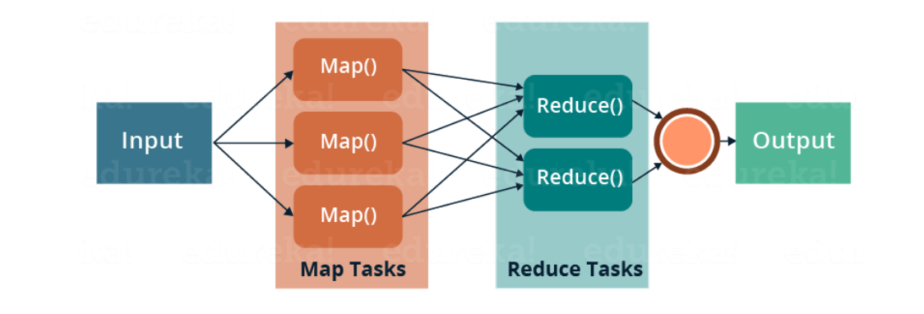
MapReduce
Programming and processing framework for large-scale data programming
Consists two primary operation
Map
Input data is processed and transformed into key-value pairs
Reduce
These key-values pairs are aggregated and processed to produce final result
Hive, use to process the data

Slide 3
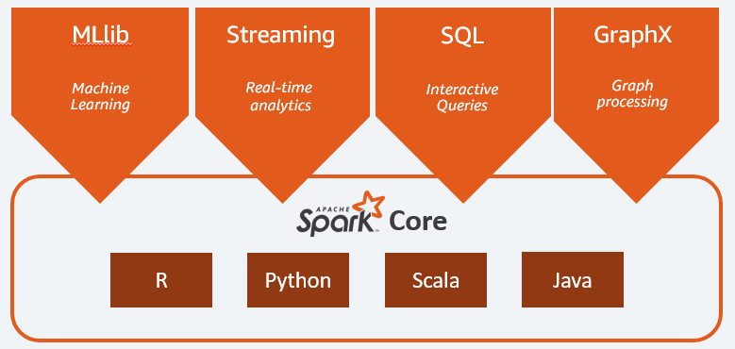
Apache Spark
open-source analytics framework used for the purpose of large-scale data processing
Components
Spark Core
Spark Streaming
Spark GraphX
Spark MLib
Spark SQL

Slide 4
Demo

Slide 5
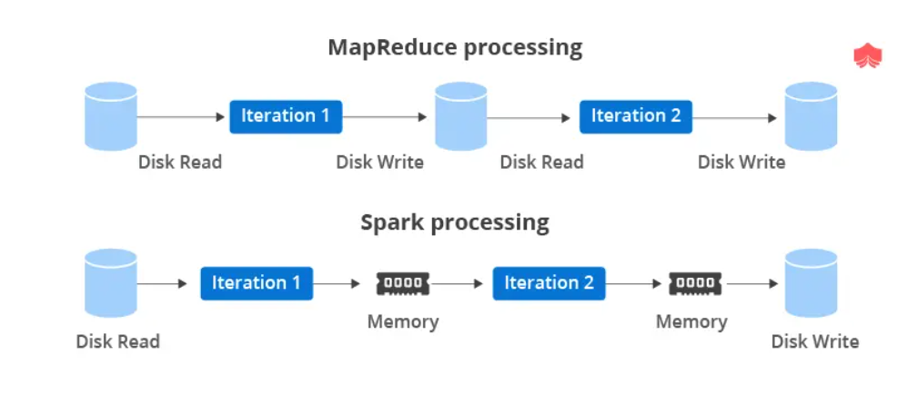
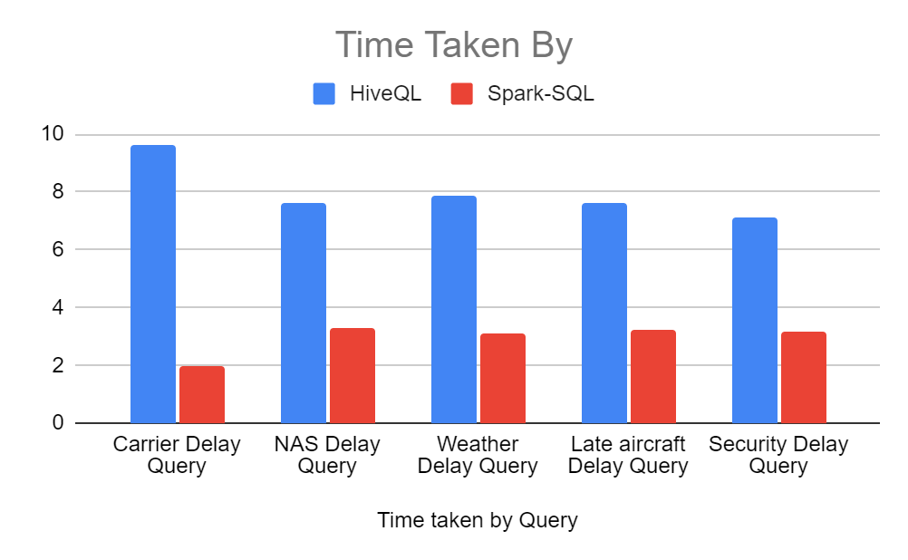
MapReduce VS Apache Spark

